Slide 1
Regenerative SDR for NOAA Satellite Reception
Project proposal - Suryasaradhi

Slide 2
Problem Statement
Reception of live NOAA satellite weather signal with minimum power consumption no internet
Expensive components to downconvert high frequency signals
Creation of a low-cost SDR with minimal components
No mixer
No Separate filter
No separate amplification stage

Slide 3
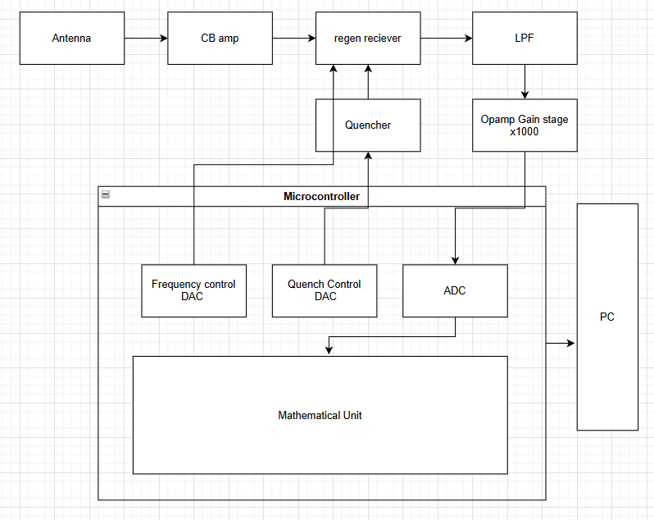
Approach
Fine and coarse control through quench and frequency control
Opamp adjustable gain stage
CB amp attenuator for Isolation
Use direct sampling

Slide 4
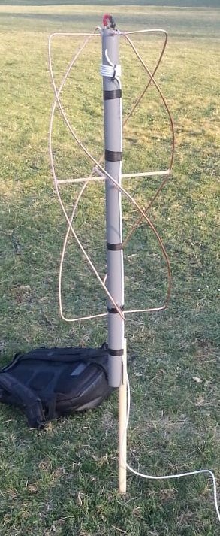
Implementation
Build helical antenna – 135-140 Mhz, 50 ohms
Test antenna – VNA (NanoVNA)
Confirm VSWR less than 3 for the band
Satellite | Frequency (MHz) | Notes
NOAA-15 | 137.620 | Active
NOAA-18 | 137.9125 | Active
NOAA-19 | 137.100 | Active
NOAA-14 | 137.620 | Decommissioned
NOAA-17 | 137.500 | Decommissioned

Slide 5
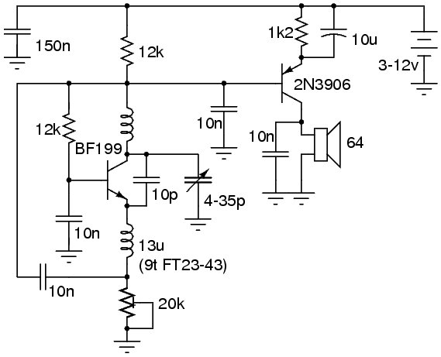
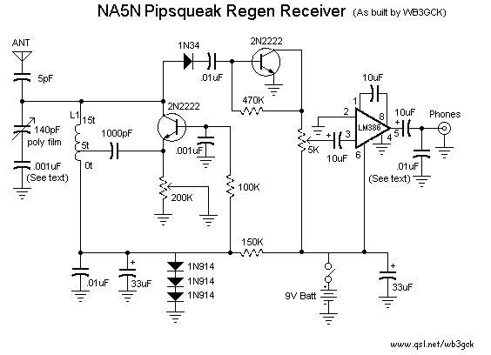
Implementation
Implement regenerative SDR in hardware – Simulation is close to impossible
Explore Super regeneration
Tested design
Unverified Super Regen

Slide 6
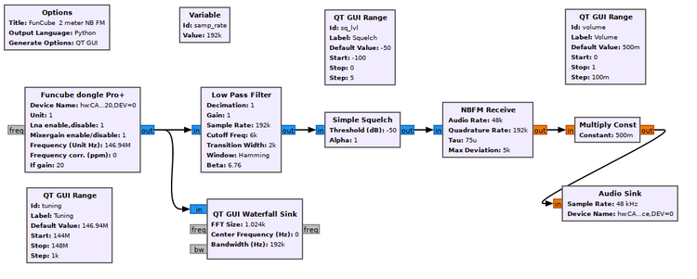
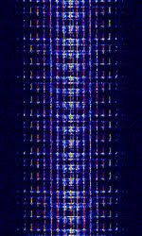
Software
Implement GNU radio interface
Implement streamer for gnu radio
Create math blocks for doing operations on the received data
Create flowgraph
Implement quench clear control
Microcontroller
STM32F4 (No FPGA – Overcomplicated)
Target Sampling Rate: 3Mhz (1Mhz Nyquist’s Bandwidth)

Slide 7
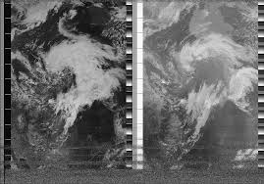
Results
Realised SDR
Less than 10mw power consumption for hardware
A mini portable weather station
Analysed frequency response of a regenerative reciever

